Slide 1
USER EXPERIENCE (UX)
AND
USER INTERFACE (UI)
DESIGN
By:
Abd-ur-Rehman Shamsi

Slide 2
INTRODUCTION
Graphic Designers:
Create visual concepts to communicate information.
UI Designers:
Create presentation and interactivity of a product.
UX Designers:
Analyze the intent of the user and goal of the business to make successful and easy experience.

Slide 3

UX DESIGN

Slide 4

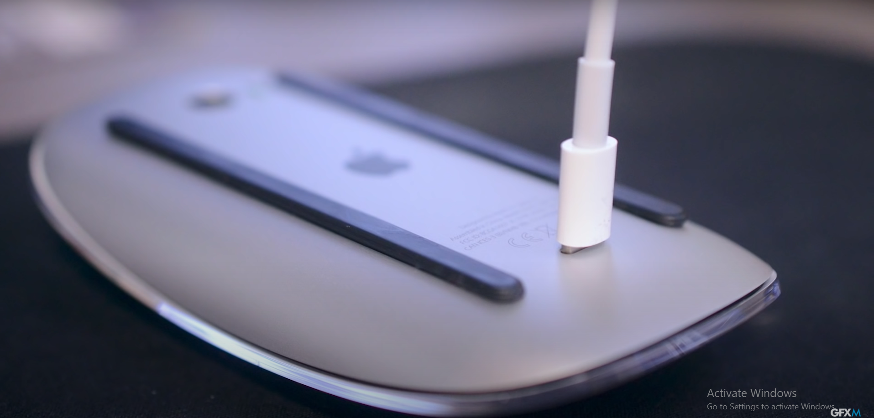
DEFINITION
UX, or User Experience, is a measure of the ease and pleasure users enjoy when using a product.

Slide 5
RESEARCH IN UX DESIGN
Problems after the design can be avoided.
It is always good to plan and then execute.
We get to know the need of user, pain points, behavior of the user and most importantly their demographic data.
Research about competitors gives us points to improve.
Types of Research:
Qualitative Research
Quantitative Research

Slide 6
GENERATIONAL UX DESIGN
Design patterns vary; designs that work for one generation may not work for another.
Baby Boomers
Value wellness for life and independent choice.
Design should be considering eyesight, motor skills and memory.
Gen X
Value sincerity and security.
Design should be straight forward and simple.
Maximum details, data charts, facts etc.

Slide 7
GENERATIONAL UX DESIGN
Millennials
Value time saving and convenience.
Design should be fast loading, seamless.
Add bullets, related items etc.
Gen Z
Tech savvy but risk averse.
Short Attention span (8 Seconds).
Rely on algorithms and creators.
Gen Alpha
Obsessed with technology and gadgets.
Range of visual, voice and motor skills.

Slide 8

UI DESIGN

Slide 9
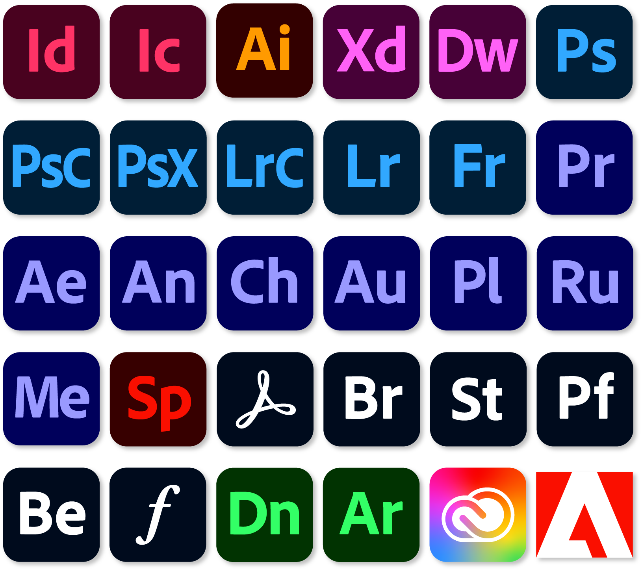
DEFINITION
Human-computer interaction and communication in a device.
UI is how it looks while UX is how it feels.
Tool used: Adobe Xd
Fast and easy.
Targeted primarily to designing and prototyping.

Slide 10
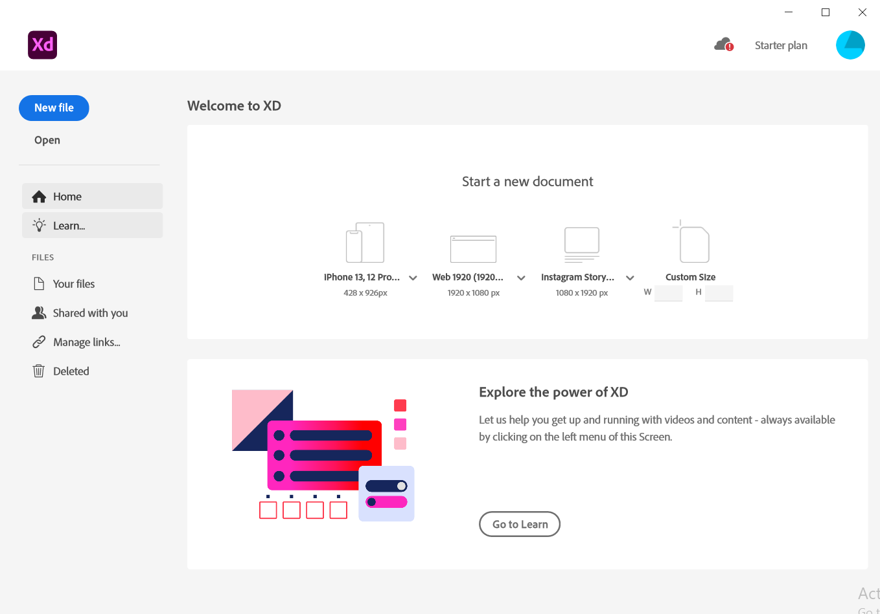

Slide 11
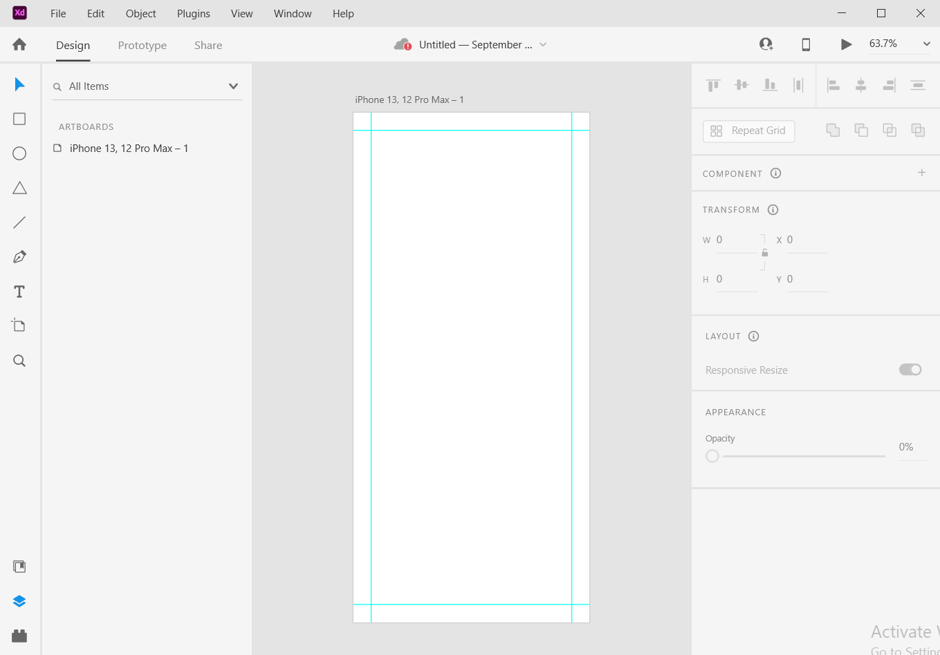

Slide 12
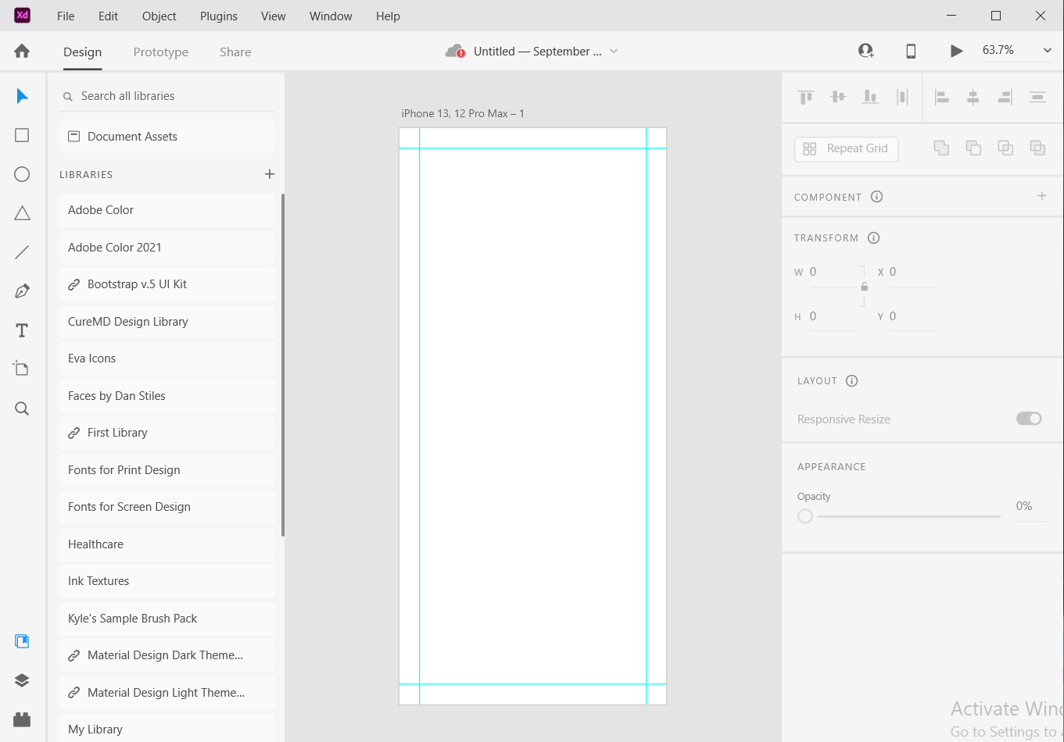

Slide 13
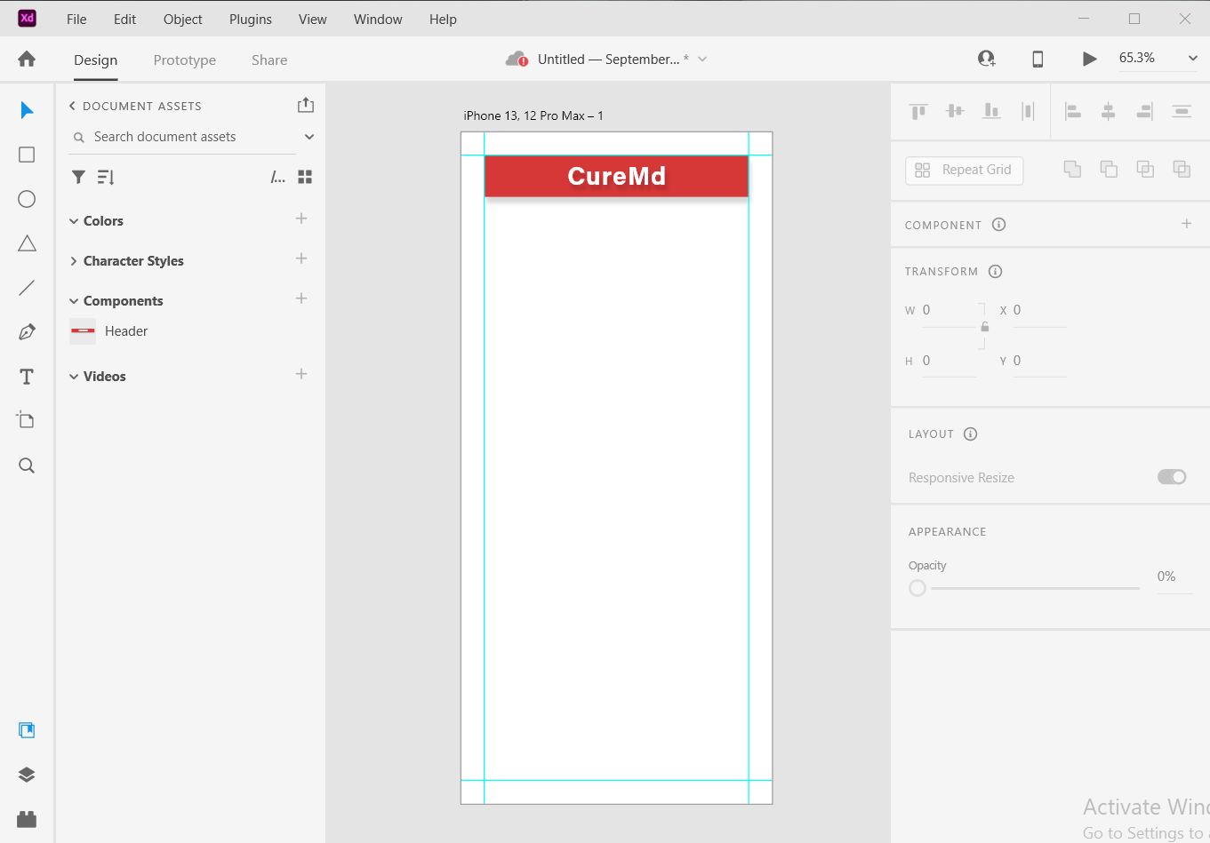

Slide 14
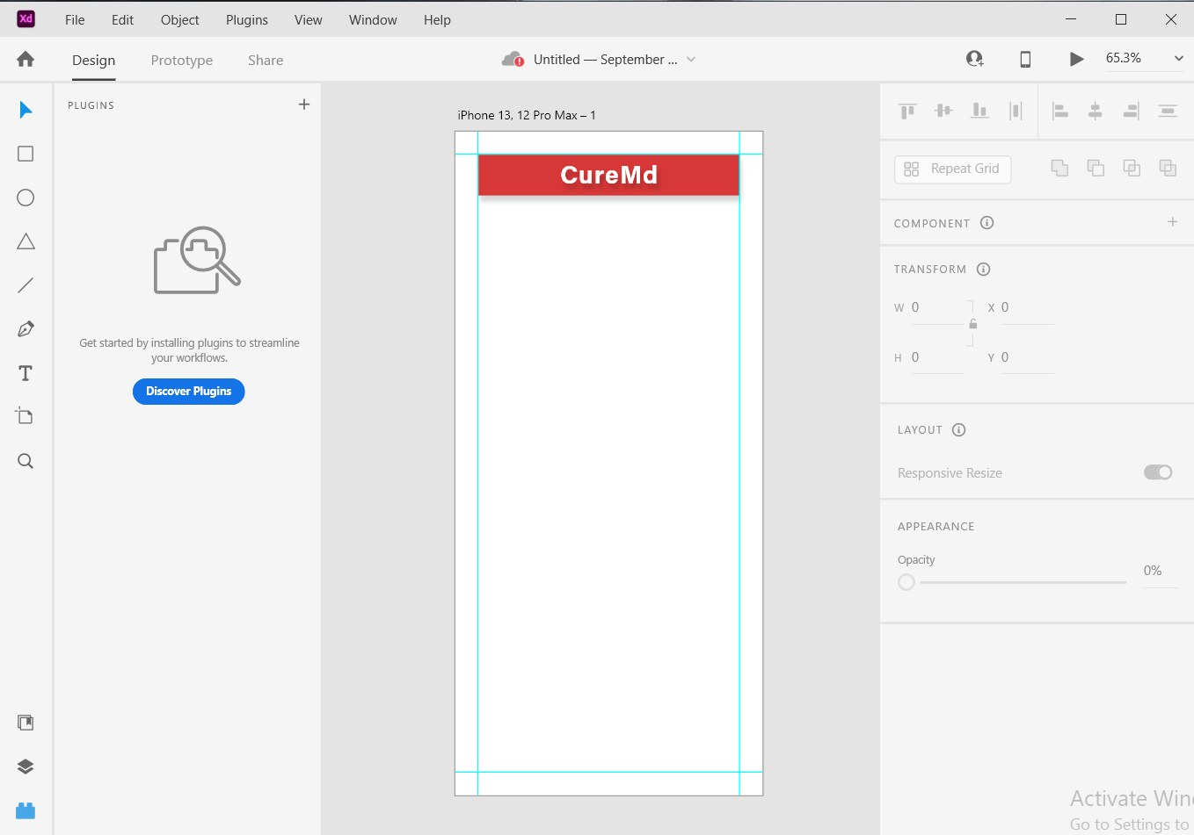

Slide 15
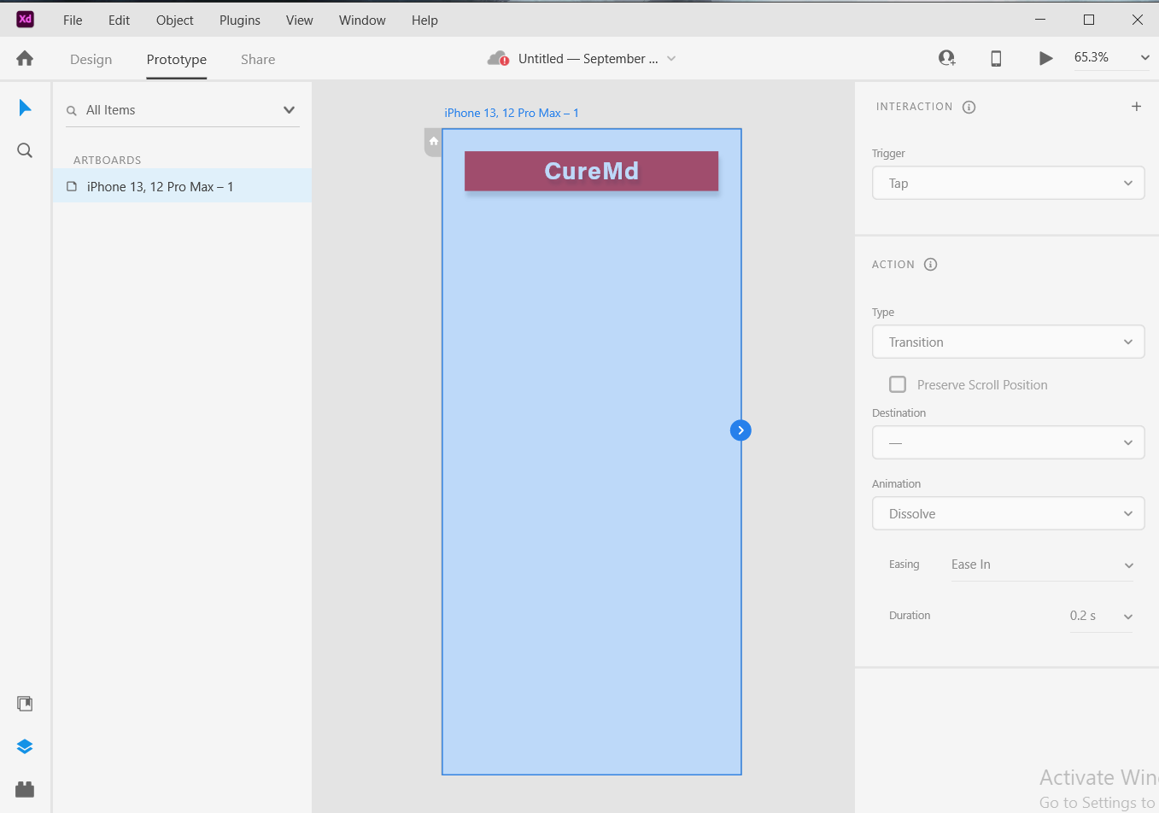

Slide 16
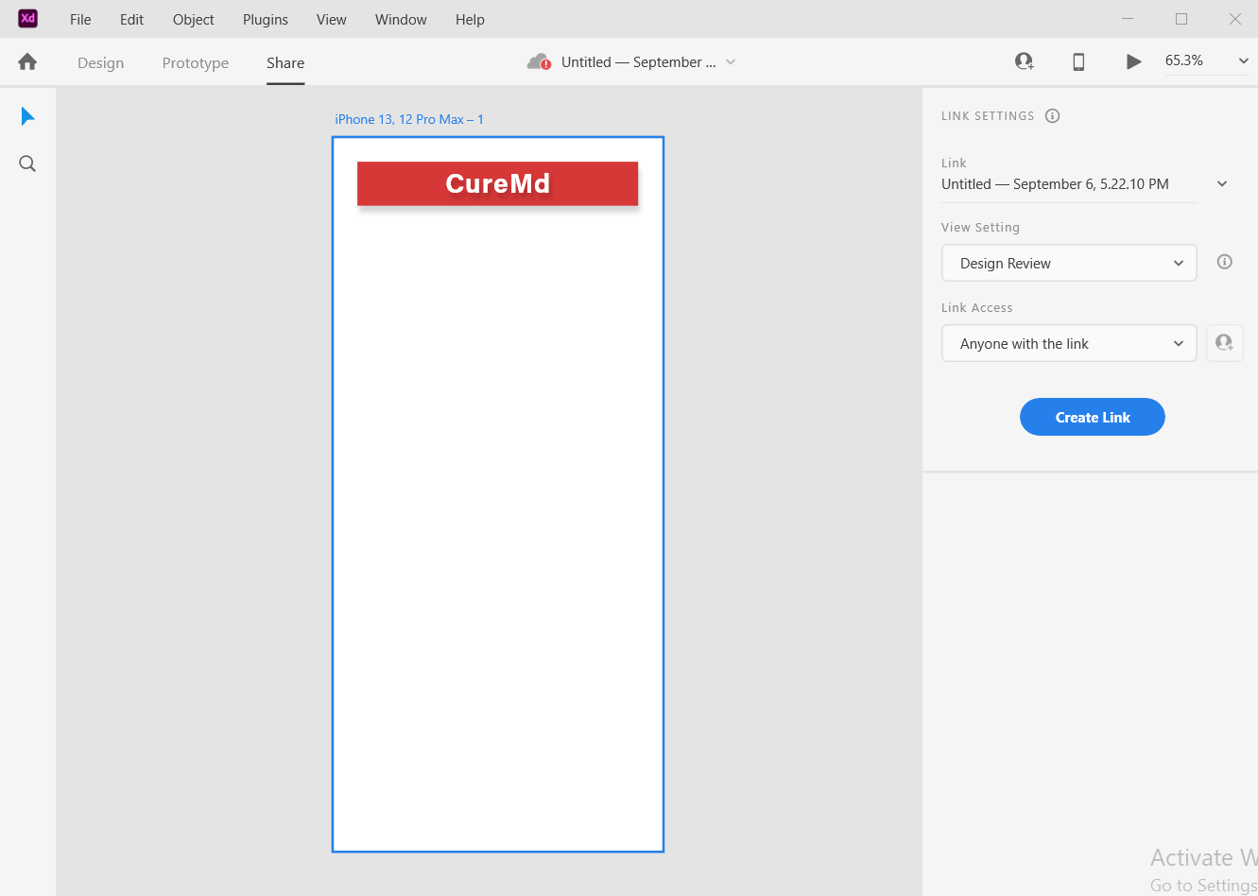

Slide 17
REFERENCES
“UX Foundations: Generational Design” by Sarah Weise
(LinkedIn Learning)
“Adobe XD for Designers” by Paul Trani
(LinkedIn Learning)
“UX / UI” by GFX Mentor
(YouTube)

